Slide 1
Solar filaments, explained
A beginner’s guide to the Solar Filament Segmentation Challenge 2026
The science, the data, and the rules
Source pages checked 24 October 2026
01
Notes:
Source: https://www.kaggle.com/competitions/filament-segmentation-2026
Accessed 24 October 2026.

Slide 2
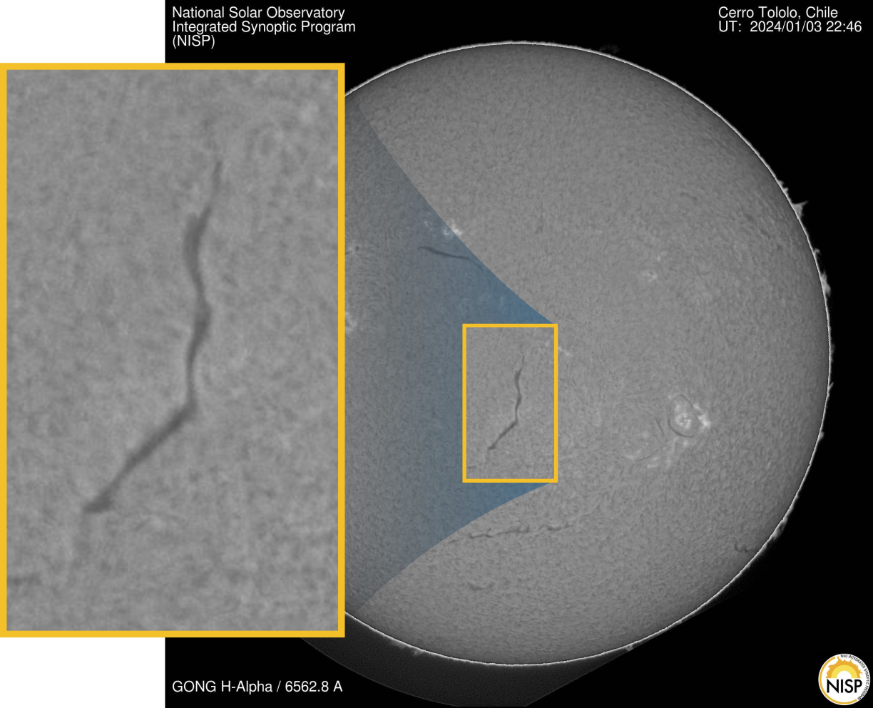
Clouds above the Sun
Solar filaments are dense clouds of solar material held above the Sun by magnetic fields.
They look dark against the bright solar disk in H-alpha images, which isolate a particular wavelength of light.
02
Notes:
Source: https://www.kaggle.com/competitions/filament-segmentation-2026
Accessed 24 October 2026. Illustration from competition overview.

Slide 3
Why astronomers care
Filaments are involved in solar eruptions. Some eruptions send material toward Earth.
These events can disrupt satellites, GPS and electricity grids. Mapping filaments supports space-weather research.
This challenge maps filament shapes. It does not directly predict an eruption.
03
Notes:
Source: https://www.kaggle.com/competitions/filament-segmentation-2026
Accessed 24 October 2026.

Slide 4
The computer’s task
Segmentation means coloring in the pixels that belong to an object. A pixel is one tiny square in a digital image.
Here, the program must outline each filament separately, including its thin branches, while leaving the background out.
04
Notes:
Source: https://www.kaggle.com/competitions/filament-segmentation-2026
Accessed 24 October 2026.

Slide 5
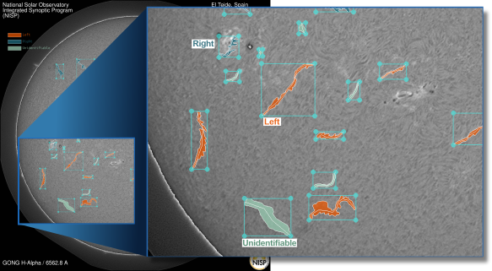
The answer is a mask
A mask marks the pixels belonging to one filament. Each filament needs its own mask.
The organizer’s examples show solar images alongside human annotations. These examples teach us what a good outline looks like.
05
Notes:
Source: https://www.kaggle.com/competitions/filament-segmentation-2026
Accessed 24 October 2026. Illustration from competition overview.

Slide 6
How machine learning fits in
Training: show a model solar images paired with human-drawn masks so it can learn useful patterns.
Validation: check it on held-out training images that it did not learn from.
Inference: ask it to produce masks for unseen test images. Traditional image-processing methods are also allowed.
06
Notes:
Source: https://www.kaggle.com/competitions/filament-segmentation-2026
Accessed 24 October 2026.

Slide 7
What the download contains
MAGFiLO is the collection of manually annotated GONG solar images used here.
train/train_images/ contains learning images.
train/MAGFiLO_1.0_Annotations_kaggle2026_train.json contains their human annotations.
test/test_images/ contains images for your predictions. Test answers are hidden.
07
Notes:
Source: https://www.kaggle.com/competitions/filament-segmentation-2026/data
Accessed 24 October 2026.

Slide 8
The images in plain language
Each image is 2048 × 2048 pixels, in 8-bit grayscale JPEG format. Treat it as brightness data rather than color.
GONG is a network of ground-based solar instruments. H-alpha is the type of observation they provide here.
The Data page lists 888 files totaling 750.97 MB. This is a file count, not a verified training-image count.
08
Notes:
Source: https://www.kaggle.com/competitions/filament-segmentation-2026/data
Accessed 24 October 2026.

Slide 9
The annotation file
JSON is a structured text file. COCO-style describes how its image records and object annotations link together.
A segmentation describes a filament’s outline. Convert it into a mask for learning or scoring.
The file also includes boxes, spines and category labels. The overview restricts training to the permitted segmentation ground truth.
09
Notes:
Source: https://www.kaggle.com/competitions/filament-segmentation-2026/data
Accessed 24 October 2026.

Slide 10
Repeated images and compressed masks
Different people may independently annotate the same solar image. Their records can have different IDs but the same underlying picture.
For an honest local validation check, keep all copies of a picture in the same split. This is a suggested ML practice.
RLE means run-length encoding: a compact, lossless way to store a mask. The supplied pycocotools library helps convert formats.
10
Notes:
Source: https://www.kaggle.com/competitions/filament-segmentation-2026/data
Accessed 24 October 2026.

Slide 11
What makes a good prediction
Fine branches: capture the thin extensions as well as the main body.
Clean background: avoid confusing noise or other dark features with a filament.
Separate objects: avoid breaking one filament into pieces or joining neighboring filaments together.
11
Notes:
Source: https://www.kaggle.com/competitions/filament-segmentation-2026
Accessed 24 October 2026.

Slide 12
How results are judged
The updated leaderboard metric is Panoptic Quality (PQ). It rewards overlapping shapes and correct identification of individual objects.
IoU measures shared area divided by total covered area. Example: 60 shared pixels out of 100 covered pixels gives IoU = 0.60.
The final rubric is 70% quantitative and 30% qualitative, including apparent shape quality, the pipeline explanation and code quality.
12
Notes:
Source: https://www.kaggle.com/competitions/filament-segmentation-2026
Accessed 24 October 2026.
PQ explanation is simplified for beginners. The updated leaderboard section supersedes legacy Dice language.

Slide 13
The prediction file
Upload one CSV spreadsheet-style file for the whole test set. Each row represents one predicted filament.
filament_id: the unchanged image ID plus a unique suffix, such as 20150125172714Mh_1.
segmentation_rle: the encoded mask counts. Use the organizer’s pycocotools guidance. Masks use the original 2048 × 2048 size.
13
Notes:
Source: https://www.kaggle.com/competitions/filament-segmentation-2026
Accessed 24 October 2026.

Slide 14
Participation and fair play
One Kaggle account per person. A team can have up to 5 people. At most 5 submissions per day and 2 final submissions for judging.
No private code or data sharing between separate teams. Public code sharing belongs on the competition’s Kaggle forum or notebooks.
Do not use hand-labeled validation or test answers in submissions. Team mergers must meet the deadline and combined submission limits.
14
Notes:
Source: https://www.kaggle.com/competitions/filament-segmentation-2026/rules
Accessed 24 October 2026.

Slide 15
Data, tools and prize eligibility
Competition data are for noncommercial competition, education and academic research. The Data page lists CC BY-NC 4.0.
External data and models must meet access, cost and licensing rules. At inference, only the supplied test H-alpha images may be used.
AI and AutoML tools are allowed. Prize candidates must understand, explain and reproduce the solution. Eligibility also depends on age, location and conflict-of-interest rules.
15
Notes:
Source: https://www.kaggle.com/competitions/filament-segmentation-2026/rules
Accessed 24 October 2026.

Slide 16
The final hand-in includes more than a CSV
For final evaluation, complete the organizer’s Google form with a 4-page technical report PDF and a public Git repository.
Include a notebook covering the whole pipeline, requirements.txt with package versions, and trained model weights so judges can reproduce predictions without retraining.
Keep the repository public through the winner announcement. Winners have code, documentation, licensing and prize paperwork obligations.
16
Notes:
Source: https://www.kaggle.com/competitions/filament-segmentation-2026
Accessed 24 October 2026.

Slide 17
Dates and scoring need a final check
The header shows a close of 15 November 2026 at 11:30 am IST. Important Dates says 15 November at 11:59 pm CDT. These are different times. Confirm the deadline with the hosts and work to the earlier displayed close.
Updated sections specify PQ. Some older text still says Dice, and announcement thresholds use inconsistent scales. The current evaluator and host clarification should guide interpretation.
The prize pool is up to $3,000 with a dynamic split across the top three teams.
17
Notes:
Source: https://www.kaggle.com/competitions/filament-segmentation-2026
Accessed 24 October 2026.

Slide 18
A manageable first attempt
Inspect a few training images with their masks. Check that each mask lines up with its image.
Reserve a separate validation set. Try a simple image-processing baseline or a small segmentation model.
Inspect missed branches and merged objects, run the organizer’s self-evaluation notebook, then test CSV encoding before a full submission.
18
Notes:
Source: https://www.kaggle.com/competitions/filament-segmentation-2026
Accessed 24 October 2026.

Slide 19
Sources and further reading
Competition overview: problem, evaluation, dates and final hand-in
https://www.kaggle.com/competitions/filament-segmentation-2026
Data: file structure, images and annotations
https://www.kaggle.com/competitions/filament-segmentation-2026/data
Rules: participation, permitted use and winner obligations
https://www.kaggle.com/competitions/filament-segmentation-2026/rules
19
Notes:
Source: https://www.kaggle.com/competitions/filament-segmentation-2026
Accessed 24 October 2026.

